Slide 1

ECE 530 Cloud Computing
Ioannis Papapanagiotou
Active Cloud storage

Slide 2
Persistent Cloud Storage
IaaS providers can support different types of hardware storage:
Ephemeral Storage
Block Storage
Object Storage
Data archiving

Slide 3
Storage access

Slide 4
Ephemeral Storage
Ephemeral storage is used to store data in the compute instance.
The lifetime of the data are based on the lifetime of the instance
For example, if we deploy a PaaS data store, aka database, on an instance, we need to have a logic for data replication.
IaaS provider provide an instance family that include High Storage Instances
very fast SSD-backed instance storage
optimized for very high random I/O performance,
provide high IOPS at a low cost.
For example i2 family
Use cases: NoSQL databases like Cassandra and MongoDB, scale out transactional databases, data warehousing, Hadoop, and cluster file systems.

Slide 5
Block Storage
Block Storage services allows the user to create storage volumes and attach them to VMs
Once attached, the user can create a file system on top of these volumes, run a database, or use them in any other ways
Block Storage volumes by most Cloud vendors, tend to be placed in a specific Availability Zone where they are automatically replicated to protect you from the failure of a single component.
Block storage volume types offer durable snapshot capabilities and are designed for 99.999% availability.
The block storage system manages the creation, attaching and detaching of the block devices to servers.

Slide 6
Block Storage
Block storage is appropriate for performance sensitive scenarios
such as database storage, expandable file systems, or providing a server with access to raw block level storage.
The user can
dynamically increase capacity
tune performance
change the type of live volumes with no downtime or performance impact.
Snapshot management: provides the functionality for backing up data stored on block storage volumes.
Snapshots can be restored or used to create a new block storage volume.

Slide 7
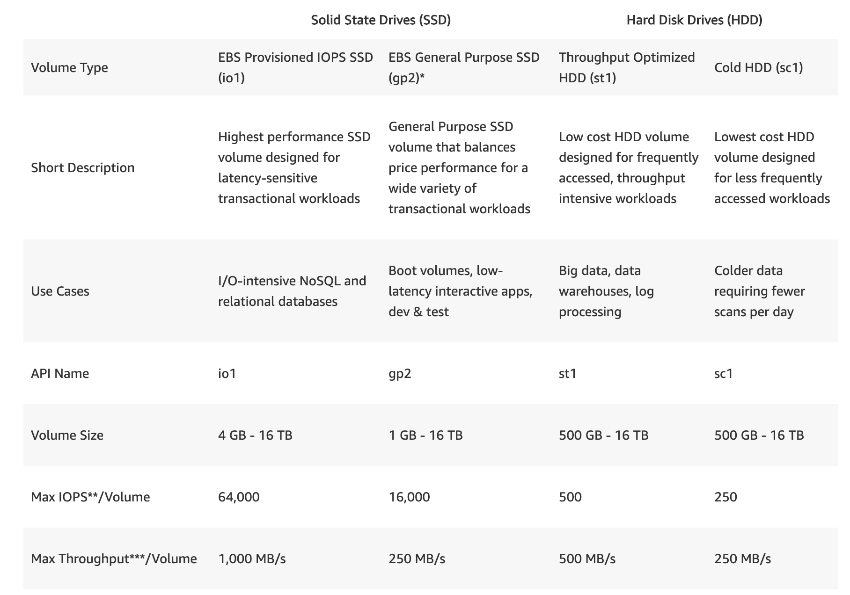
AWS EBS Volume Types

Slide 8
AWS EBS Availability and Durability
At no additional charge to the customer, Amazon EBS volume data is replicated across multiple servers in an Availability Zone to prevent the loss of data from the failure of any single component.
Amazon EBS volumes are designed for an annual failure rate (AFR) of between 0.1% - 0.2%,
failure refers to a complete or partial loss of the volume, depending on the size and performance of the volume.
This makes EBS volumes x20 more reliable than typical commodity disk drives, which fail with an AFR of around 4%.
For example, if you have 1,000 EBS volumes running for 1 year, you should expect 1 to 2 will have a failure.
EBS also supports a snapshot feature, which is a good way to take point-in-time backups of your data.

